Slide 1

Image Credit: Ayn Rand Institute/ Seita via Shutterstock.com
How does America feel about immigration?
A DATA ANALYSIS ABOUT THE IMPACT OF IMMIGRATION IN THE AMERICAN SENTIMENTS.
BY M. HASHER, J. MENDIOLA & R. ORR

Slide 2

Questions
Is there a correlation between Twitter sentiment and immigration stock and/or flows?
How other indicators are correlated with immigration?
Are sanctuary cities safer in terms of hate crime than other cities?

Slide 3

Approach
-Matching the Twitter accounts of local NPR news stations along with Twitter accounts of local television stations with counties.
-Use the data obtained along with US Census data to evaluate the relationship between the sentiment of these news Tweets and their replies with foreign-born share of the population.
DATA ANALYTICS BOOTCAMP
How America feels about immigration?

Slide 4

Data Sources
Census Data- CSV files: United States counties, population estimates, sanctuary cities, immigration rates, crime rates
Media Data- CSV files: NPR Twitter handles and local television Twitter handles
API’s- Twitter API was used to search local NPR affiliates and television station tweets by the following filters-
“Immigration , immigrant , immigrants , foreigner , non-citizen , undocumented , non-citizen ,
’permanent resident”. The API also allowed us to geo-locate the tweet.
DATA ANALYTICS BOOTCAMP
How America feels about immigration?

Slide 5
Data Exploration / Cleanup
Sentiment Analysis Notebook
Hate Crime Notebook
DATA ANALYTICS BOOTCAMP
How America feels about immigration?

Slide 6
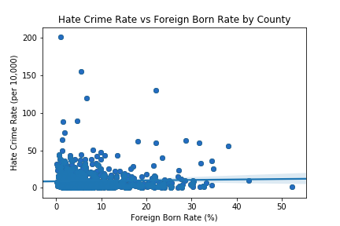
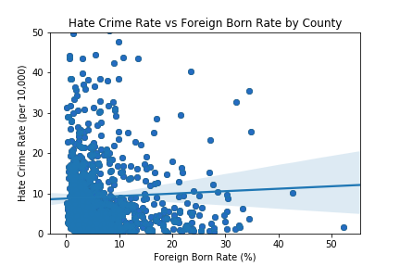
Analysis
3. Is there a correlation between hate crime rate and foreign born population rate?
DATA ANALYTICS BOOTCAMP
How America feels about immigration?

Slide 7
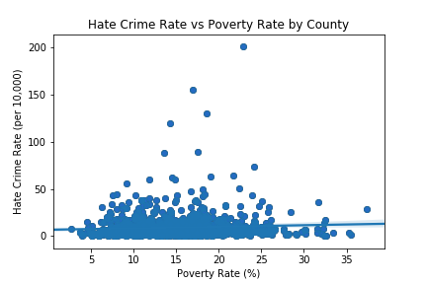
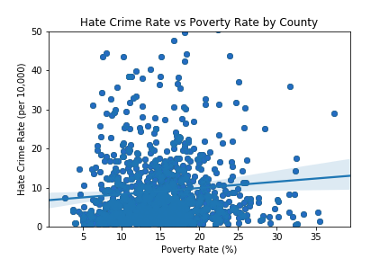
Analysis
3. Is there a correlation between hate crime rate and foreign born population rate?
DATA ANALYTICS BOOTCAMP
How America feels about immigration?

Slide 8
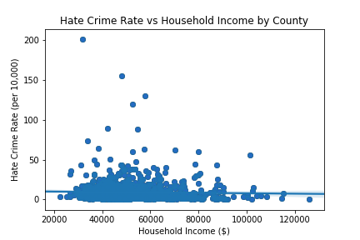
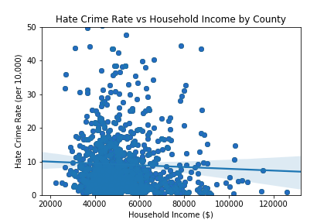
Analysis
3. Is there a correlation between hate crime rate and foreign born population rate?
DATA ANALYTICS BOOTCAMP
How America feels about immigration?

Slide 9
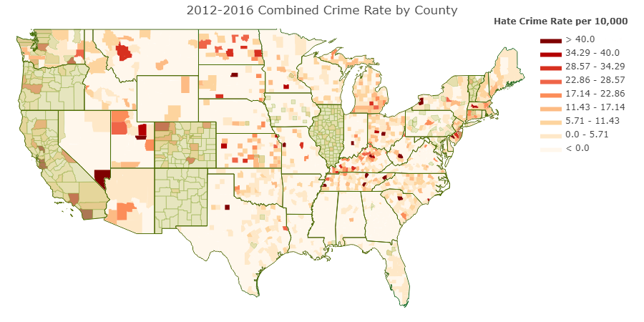
Analysis
4. Are sanctuary cities safer in terms of hate crime than other cities?
DATA ANALYTICS BOOTCAMP
How America feels about immigration?

Slide 10
Conclusions
EXAMPLE
Is there a correlation between hate crime rate and the negativity of sentiment analysis?
Based in our scatter plot we can conclude that in those counties where the sentiment analysis is negative, the hate crime rate is higher than average and….
DATA ANALYTICS BOOTCAMP
How America feels about immigration?

Slide 11
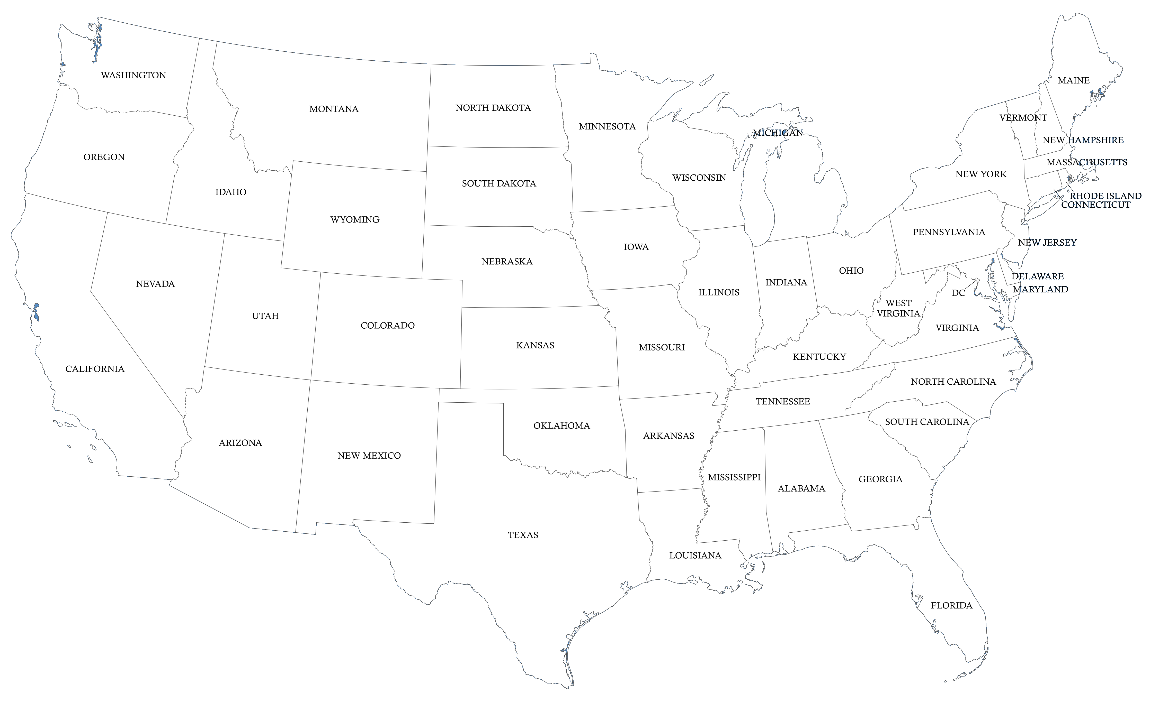
Thank you

